Slide 1
BTEC LEVEL 2 TECH AWARD
Promotion and Finance for Enterprise

Slide 2
LEARNING AIM B- FINANCIAL RECORDS
Learners will complete, interpret and check the information on financial documents and statements.

Slide 3


LEARNING AIM B- FINANCIAL RECORDS
DATE:
Objectives:
- To be able to identify different financial records used by a business as well as start up and running costs.
- To be able to explain the importance of different financial documents and their use in business.
Starter: what do you think a financial document is? Can you name any financial documents your parents might have?

Slide 4
FINANCIAL DOCUMENTS
These are formal documents representing the transactions of a business, individual or other organization. Financial records maintained by most businesses include a statement of retained earnings and cash flow, income statements and the company's balance sheet and tax returns. Keeping financial records organized is a key element in a successful business
it is important to have good financial records so that you can:
Monitor the progress of your business
Project your tax liability
Prepare your financial statements
Identify source of receipts
Keep track of deductible expenses
Prepare your tax return

Slide 5
B1- TYPES OF FINANCIAL DOCUMENTS
Type of document | Definition | Why it is important
Invoice
Delivery notes
Purchase orders
Credit notes
Receipts
Complete the table by using the internet to help you.

Slide 6
B2- PAYMENT METHODS
What are all of the different types of ways a business/customer can pay for products/services?
Debit Card
Cash
Payment Methods
Excel:
What is the difference between a credit card and a debit card?
What does the term ‘interest’ mean in relation to finance?
What is a direct debit?
Credit Card
Direct Debit
Other payment technologies

Slide 7


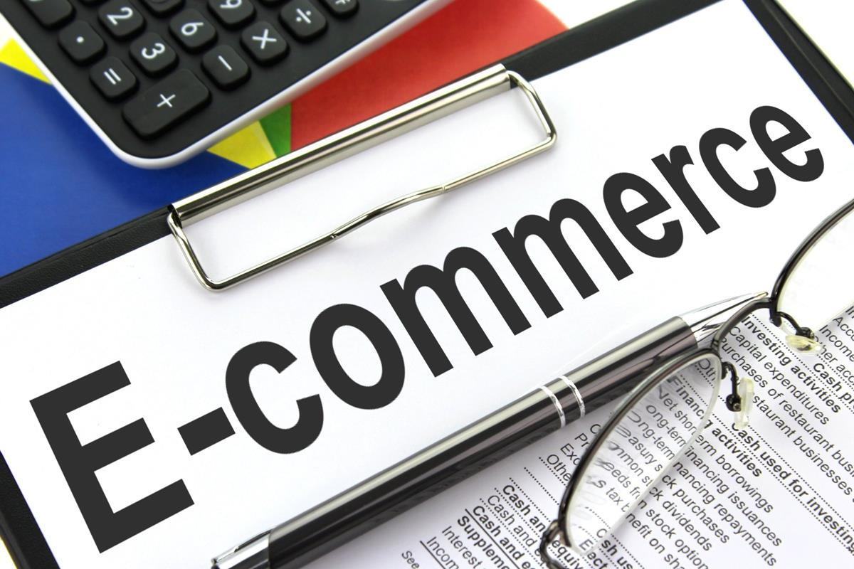

B2- OTHER PAYMENT TECHNOLOGIES…
Why have these payment methods become more popular over the past few years?

Slide 8
B2-IMPACT ON CUSTOMERS AND ENTERPRISES OF METHODS
Write a paragraph of explanation on how different payment methods help a) the business b) the customers
Then create a quick table of the pros and cons of the different payment methods. Some useful links below.
https://us.nxgen.com/advantages-and-disadvantages-of-different-payment-types/
https://www.business2community.com/strategy/pros-cons-different-payment-options-0881406

Slide 9
PLENARY QUIZ:
What is an invoice? (1)
What is a purchase order? (1)
State one reason why it is important for a business to keep accurate financial records? (1)
Name two other payment technologies used by businesses and customers. (2)
Get your shoulder partner to mark your work.

